Slide 1

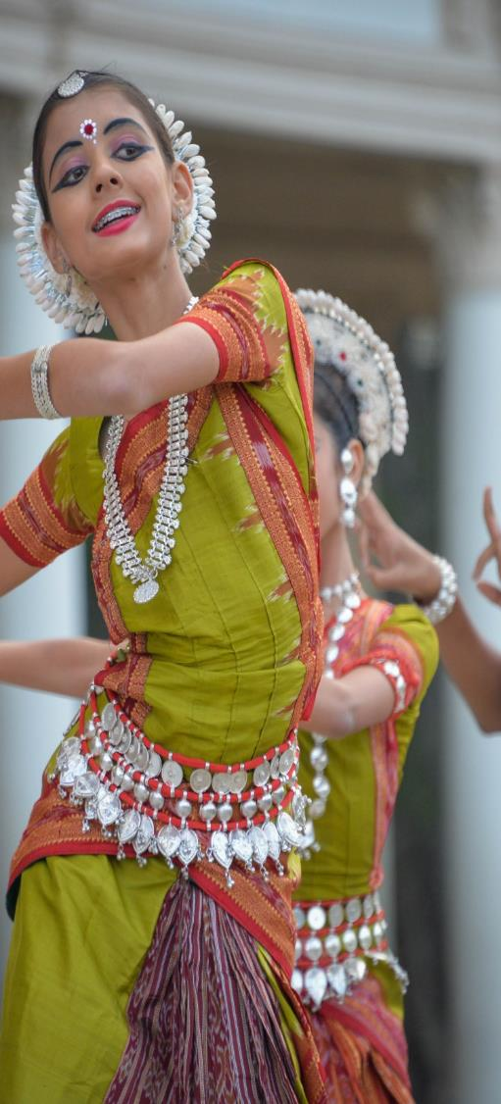



Cultural Intelligence
Australian-ASEAN Youth Summit 2017

Slide 2

What we’ll cover...
What is culture?
Importance of cultural intelligence
Developing cultural intelligence
Case Study: Can culture explain the ‘labour exploitation’ of international students?

Slide 3
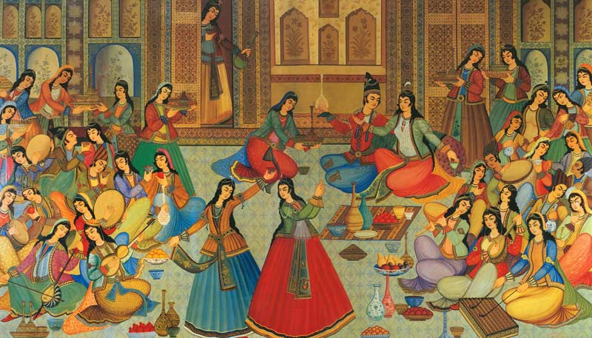
What comes to mind what you think of culture?

Slide 4
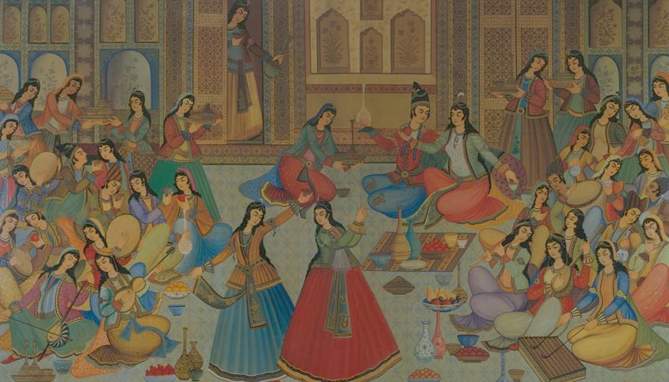
Dress
Food
Language
Festivals
Rituals
Art
Customs
Social norms
Beliefs
Traditions
Values
Expectations

Slide 5

// What is culture? Really…

Slide 6
Culture
noun | Merriam-Webster Dictionary
The integrated pattern of human knowledge, belief, and behaviour that depends upon the capacity for learning and transmitting knowledge to succeeding generations.

Slide 7
Culture
noun | etymology
middle 15c:
The tilling of land.
Cultivate. Agriculture.
1500:
Cultivation through education
1867:
Collective customs and achievements of a people
1940:
Culture shock

Slide 8
// Importance of cultural intelligence

Slide 9

Victoria is multi-cultural

Slide 10
Top 10 Overseas Country of Birth 2016
(Victorian Multicultural Commission)
England (171,443)
India (169,802)
China (160,652)
New Zealand (93,253)
Vietnam (80,787)

Slide 11
Top 10 Overseas Country of Birth 2016
(Victorian Multicultural Commission)
6. Italy (70,527)
7. Sri Lanka (55,830)
8. Philippines (51,290)
9. Malaysia (50,049)
10. Greece (47,240)

Slide 12

Imagine speaking to an Indian client on the phone.

Slide 13
You: Do you think the files can be sent to me by Friday?
Client: Okay!

Slide 14
You didn’t get the files.
What’s going on?

Slide 15
Having IQ
Without the files, the project cannot go on!
Can we do anything in the meantime?

Slide 16
Having EQ
Did I not make myself clear over the phone?
Didn’t he say “Okay”?
Did something happen?
How can I best convey the feedback to him?

Slide 17
Having CQ
(Cultural Quotient or Cultural Intelligence)
He didn’t send me the files because in Indian culture, an “okay” doesn’t always mean “Yes, I agree.”
It could mean an acknowledgement of receiving the message, like an “uh-huh”.

Slide 18
You: Do you think the files can be sent to me by Friday?
Client: Okay!
You: Just to confirm, what could we expect to be sent by Friday?
Client: The files.
You: Thanks!

Slide 19
// Developing cultural intelligence
Notes:
Head – know it, learn it, understand it
Hand – do it, try it, show it
Heart – keep trying, keep going, keep learning

Slide 20

HEAD
Know it.
Learn it.
Understand it.

Slide 21
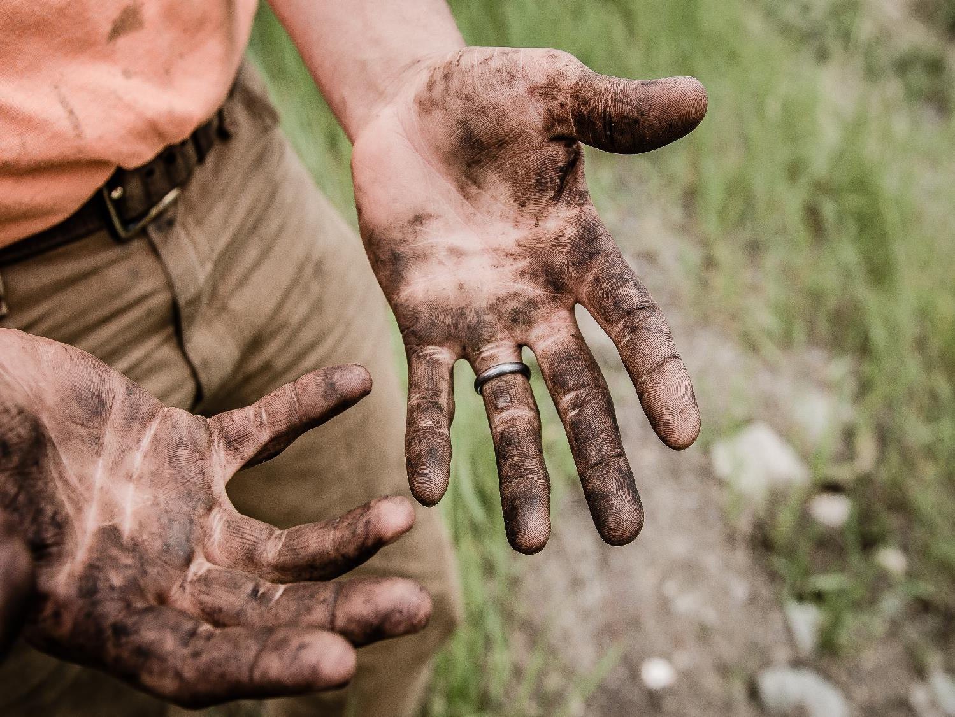
HANDS
Do it.
Try it.
Show it.

Slide 22

HEART
Keep trying.
Keep going.
Keep learning.

Slide 23
// Case Study
Can culture explain the ‘labour exploitation’ of international students?

Slide 24

Ming, 24
International student from China
Working in a dumpling restaurant
Overworked and underpaid

Slide 25
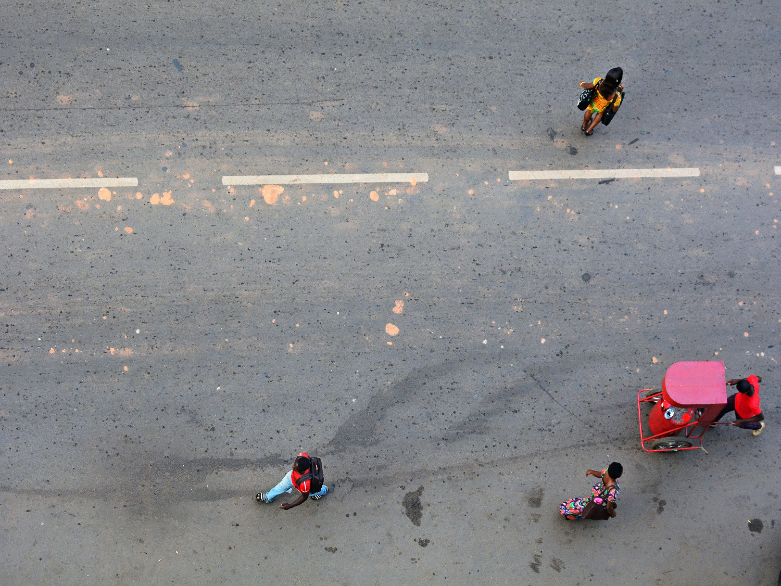
Hofstede’s Cultural Dimensions

Slide 26
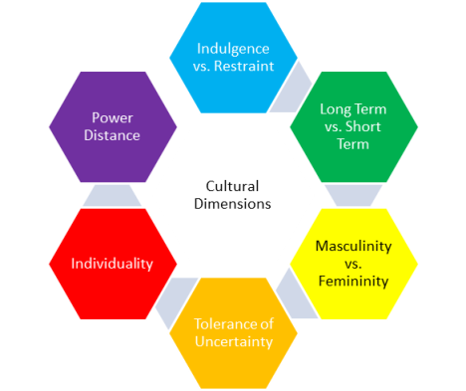

Slide 27


High power distance
The less powerful members accept and expect that power is distributed unequally.

Slide 28

Low individualism
People act in the interests of the group and not necessarily of themselves.

Slide 29

High long term orientation
Very pragmatic. A strong propensity to save and invest, thriftiness, and perseverance in achieving results.

Slide 30

Low indulgence
Restrained societies do not put much emphasis on leisure time and control the gratification of their desires.

Slide 31

Questions?

